Slide 1
APS106 – Design Problem #4 Cryptanalysis

Slide 2
Agenda
Problem Background
Learning Objectives
Coding

Slide 3
Cryptanalysis was a defining factor in WWII

Slide 4


Slide 5
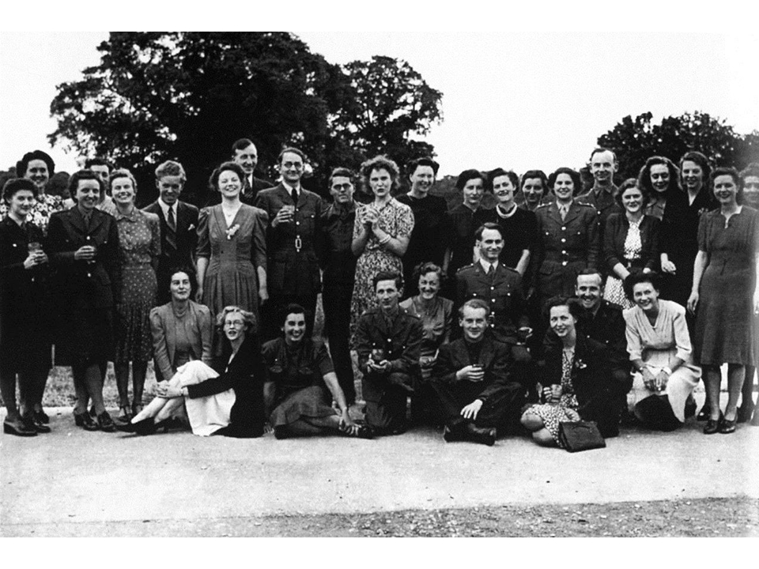
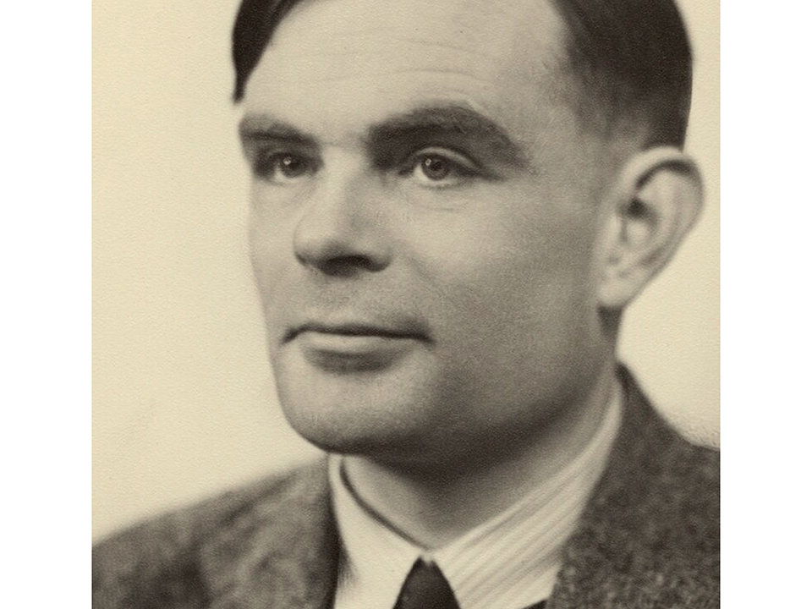
Intersectionality of history and technology
Alan Turing - The “Father” of Computer Science and Artificial Intelligence
Pioneered the technology to decrypt Nazi Germany's secret communications during World War II
Decryption machines were called “Turing machines”
Alan Turing circa 1951
Workers of Bletchley Park, principal centre of Allied Code-Breaking circa 1938
8,000 women, 75% of the workforce
Notes:
Bletchley Park was a converted private house which was taken over by the British Secret Intelligence Service (MI6 to you and me) in 1938. There was a small code-breaking organization between the wars called the Government Code & Cypher School, which was part of MI6, and they moved in just before the war began

Slide 6

Intersectionality of history and technology
Turing Award
“Nobel Prize of Computing”
2022 recipient is Robert Metcalfe, American Engineer and inventor of Ethernet
Turing Test
The test of a machine’s ability to be indistinguishable from a human
Notes:
Bletchley Park was a converted private house which was taken over by the British Secret Intelligence Service (MI6 to you and me) in 1938. There was a small code-breaking organization between the wars called the Government Code & Cypher School, which was part of MI6, and they moved in just before the war began

Slide 7
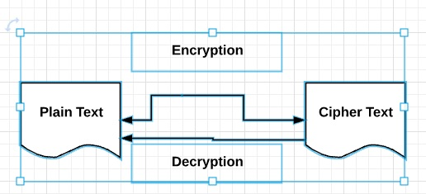
Background: Cryptanalysis
Will rely on user input, functions, for loops, conditional statements, ASCII codes, string methods, and comparison operators to create our own cryptography code!
Goal: Write a Python program that enables us to encrypt a message that can only be read by someone with the secret key.

Slide 8
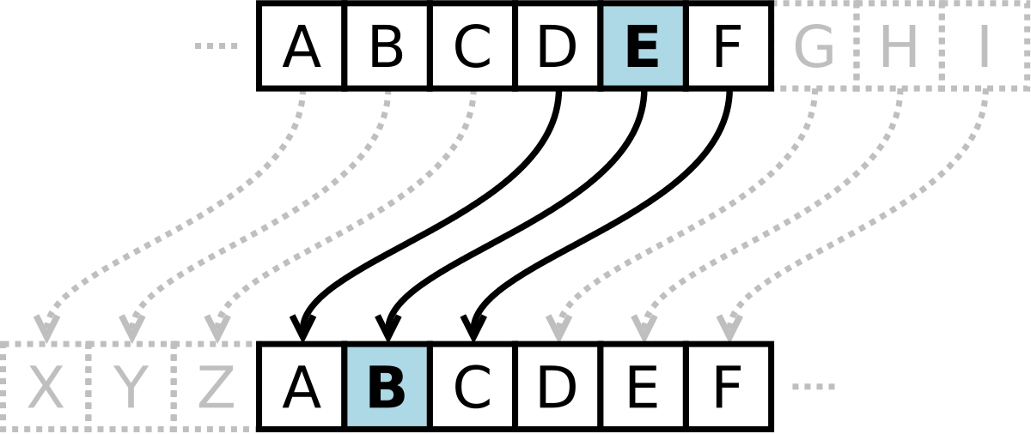
Background: Caesar Cipher
Goal: Write a Python program that enables us to encrypt a message that can only be read by someone with the secret key.
The key will represent how much we shift each letter.
Also known as a Caesar Shift

Slide 9
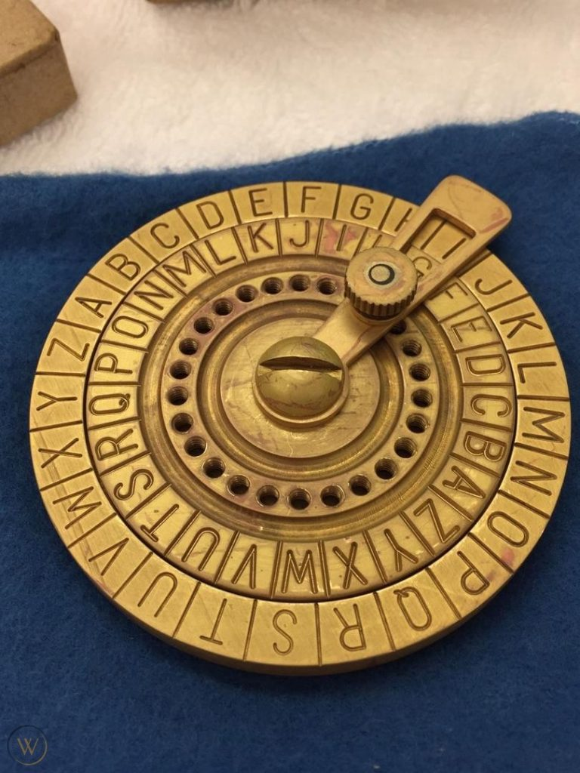
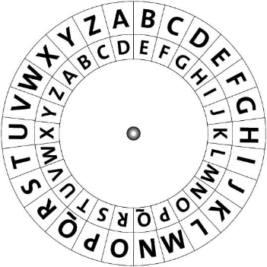
Goal: Write a Python program that enables us to encrypt a message that can only be read by someone with the secret key.
The key will represent how much we shift each letter.
Also known as a Caesar Shift

Slide 10
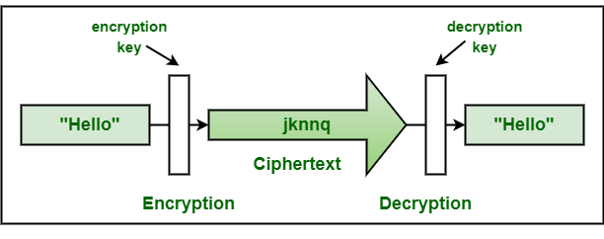
Learning Objectives
Practice combining all topics covered so far with an out-of-box application

Slide 11
Some Reminders

Slide 12
Review: Conditional Statements (if/elif/else)

Slide 13

RECAP: Making Choices
statements
Sequential structure
statements
Conditional structure
if
True
condition
statements
statements
statements
False
statements

Slide 14


Adding the elif (else if) statement
The most general form of the if conditional statement is:
if condition1:
body1
elif condition2:
body2
elif conditionN:
bodyN
else:
other_body
Note the colons (:) and the indents!
ONLY 1 body will be executed.
if statement is True, execute body1, exits if structure
if statement is False, continue to elif statement
elif statement is True, execute elif body, exits if structure
elif statement is False, continue to next elif statement
All if’s and elif’s are False, execute else statement

Slide 15
Making Choices
statements
True
if
condition
Conditional structure
False
statements
elif
True
condition
statements
False
else
statements

Slide 16
Review: Functions & User Input

Slide 17
Function Definitions
Definition
Function Name
Colon
def function_body(parameters):
body
Indent
(parameter1,
parameter2, …)
What is in the body?

Slide 18
Function Definitions
def function_body(parameters):
1. “““DOCSTRING””” (optional)
2. Code the does the thing
3. return [expression]
The return statement is options and if it is not included, it’s the same as writing return None

Slide 19
Calling Functions
In Python names of variables and functions use low case and underscores.
function_name
Function_Name
FunctionName
The general form of a function call:
Terminology
argument: a value given to a function.
pass: to provide an argument to a function.
call: ask Python to execute a function (by name).
return: give a value back to where the function was called from.
function_name(arguments)

Slide 20
Input
Python has a built-in function named input for reading text from the user.
The general form of a input function call:
The argument is the text you want displayed to the user.
“What is your name?”
The value returned by the input function is always a string.
input(argument)

